Slide 1

EQUITY TRADING USING DEEP REINFORCEMENT LEARNING
Author : Ashok Jana

Slide 2
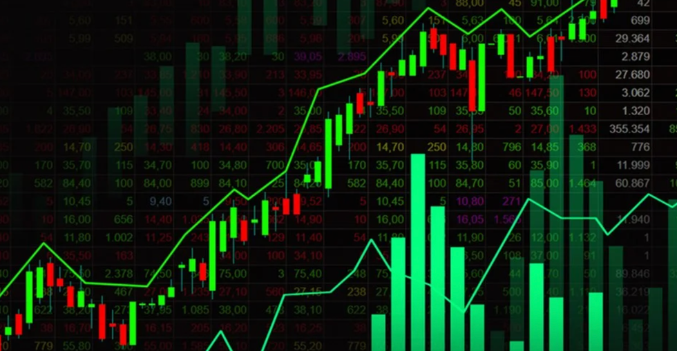
Introduction
Stock markets go up, down, and sometimes crash.
Most people panic during crashes.
We wanted an intelligent system that stays calm and adapts.
The focus was smart decision-making, not guessing.
Problem Statement : How can automated trading agent learn to adopt different strategy across different market conditions

Slide 3
DATASET & ASSETS USED
Downloaded the dataset from yahoo finance
Assets: SPY, AAPL, MSFT, JPM, XOM, JNJ.
Includes Bull Market, COVID Crash (2020) and Recovery period.

Slide 4
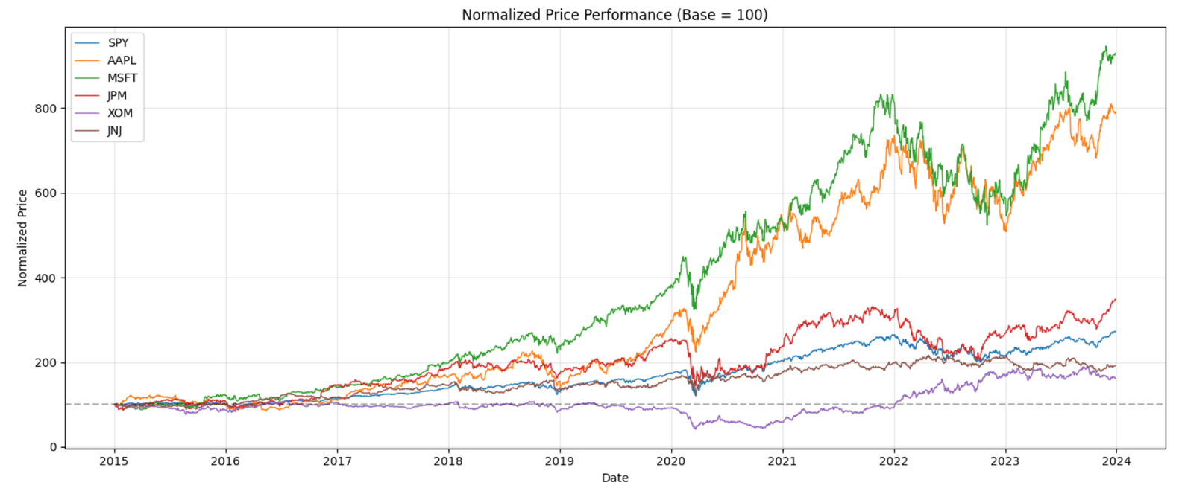
CLEANING THE DATA
Make sure all stocks had matching dates to ensure all the dates are aligned properly
Removed missing or incorrect entries.
Normalized the price to understand which assert has highest market cap

Slide 5
FEATURE ENGINEERING
I developed 27 features from raw OHLCV data including momentum, trend, volatility, and volume indicators .
These features help the AI to understand market mood.

Slide 6
TRADING ENVIRONMENT
Created a virtual stock market environment.
Starting money: $10,000.
The AI could: Buy, Sell or Hold.
Each trade had a small fee (0.1%) like real markets.
If portfolio value increases → reward.
If it loses money → penalty.
Over time, it learns which actions work best.

Slide 7
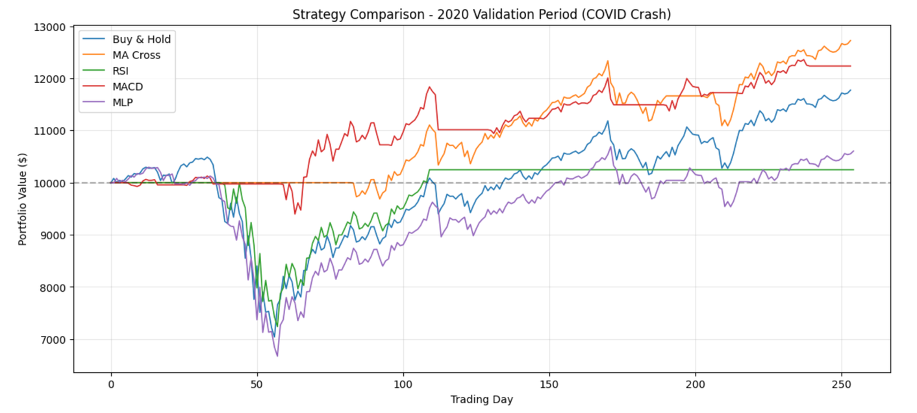
TESTING STRATEGY FINDINGS
Before AI, tested normal strategies:
Buy & Hold - good money but suffers during crashes.
Moving Average strategy - reduces crash damage
RSI and MACD strategies suffering sudden crashes
Random trading - loses money due to fees.

Slide 8
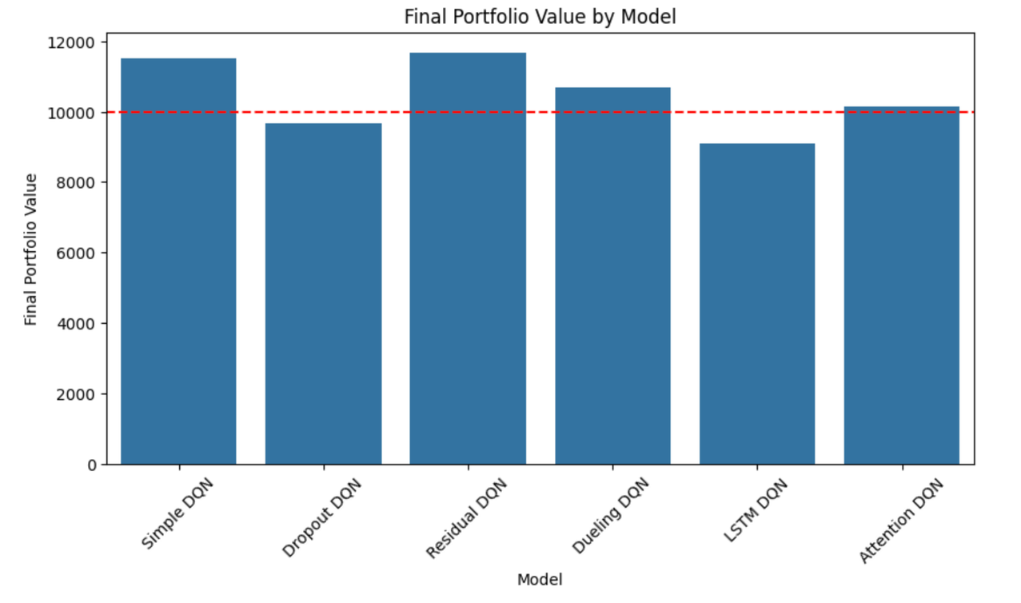
MODEL BUILDING
Trained 6 different AI models.
Simple DQN
Dropout DQN
Residual DQN
Dueling DQN
LSTM DQN
Attention DQN
At first, the model acted randomly having more loses
Slowly it started finding better buy/sell timing.
Simple DQN ,and Residual DQN models performed well in training.

Slide 9
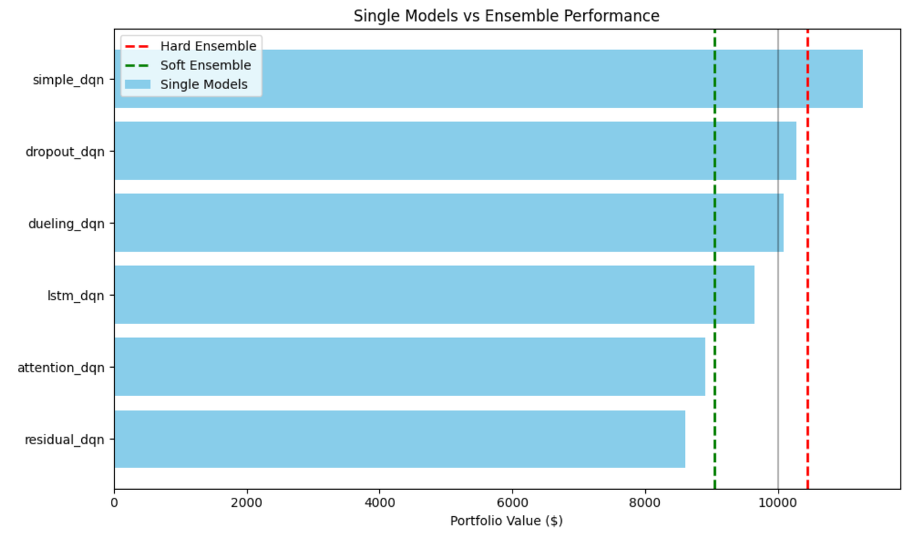
ENSEMBLE TRAINING
Hard Voting: Majority decision wins
Soft Voting : Averages model confidence scores
Stacking: Another model decides which to trust.

Slide 10
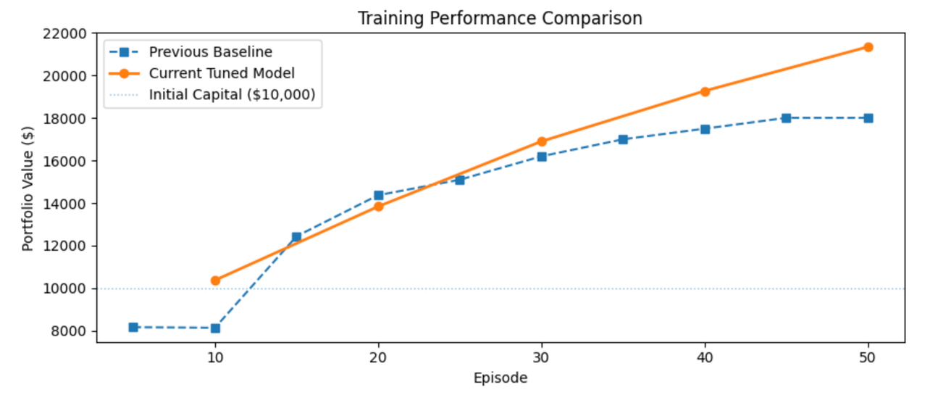
HYPERPARAMETER TUNING
Hyperparameter tuning performed on Simple DQN Model by adjusting learning rate 0.001 to 0.0001 , epsilon delay and batch size
Training Value improved:
$18,010 → $21,347.
Validation improved:
$11,277 → $12,641 (+12%).

Slide 11
ENSEMBLE OPTIMIZATION
In ensemble optimization I weighted top-2 ensemble I selected Simple DQN and Dropout DQN based on validation portfolio performance. Their Q-values were combined using weighted averaging, where the stronger model was given a higher weight. The final action was selected using the highest combined Q-value, and this ensemble strategy improved the validation portfolio value to $12,589, outperforming individual models

Slide 12
CONCLUSION
Successfully built an intelligent trading system.
Hyperparameter tuning gave biggest improvement.
Best result achieved using a weighted AI combination.
The project proves AI can learn disciplined trading behavior.

Slide 13
THANK YOU

